Slide 1
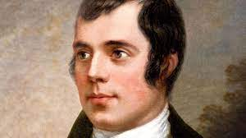
Robert BURNS
By Evangelia Pantazaki

Slide 2
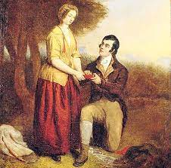
introduction
Robert Burns belongs to the poets of the romantic period of the 18th century. The romantic movement came as a reaction to the Industrial Revolution and the rationalization of nature. He is considered as the national poet of Scottland.
The parting of Robert Burns and His Mary. Painting 1844

Slide 3
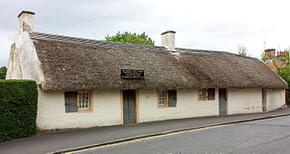
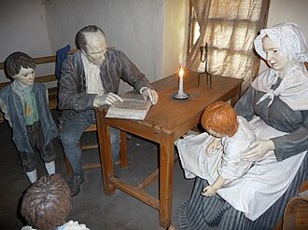
Early years
Robert Burns, often referred to as the "Bard of Ayrshire" or the "Ploughman Poet," was born on January 25, 1759, in Alloway, a small village in Scotland. He came from a humble background, with a family engaged in farming, and his early education was limited. Despite his modest upbringing, Burns displayed a deep love for literature and a natural talent for poetry. His self-education allowed him to become one of the most celebrated poets in Scottish and world literature.
The Burns Cottage in Alloway, Ayrshire
Inside Robert Burns house.

Slide 4
His education
He was given irregular schooling and a lot of his education was with his father, who taught his children reading, writing, arithmetic, geography, and history and also wrote for them A Manual of Christian Belief. He was also taught and tutored by the teacher John Murdoch, who taught Latin, French, and mathematics to both Robert and his brother Gilbert from 1765 to 1768 until Murdoch left the parish. After a few years of home education, Burns was sent to Dalrymple Parish School in mid-1772 before returning at harvest time to full-time farm labouring until 1773, when he was sent to lodge with Murdoch for three weeks to study grammar, French, and Latin.

Slide 5
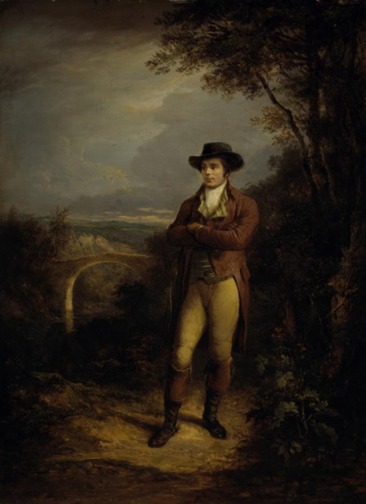
His Inspiration and MOST FAMOUS POEMS
Burns was a romantic poet so he was inspired by nature and he embraced imagination and feeling as opposed to reason .Burns' poetic journey began in his teenage years when he wrote his first poems. In 1786, he published a collection of his work titled "Poems, Chiefly in the Scottish Dialect." This collection included some of his most famous works, such as "To a Mouse" and "The Cotter's Saturday Night." The poems in this volume captured the essence of rural life in Scotland, celebrating its beauty, exploring human nature, and addressing social and political issues.

Slide 6
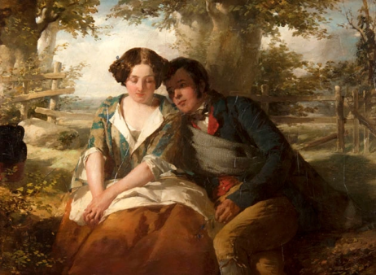
His accomplishments
Robert Burns, the celebrated Scottish poet, achieved a range of notable accomplishments during his relatively short life, which have left a lasting legacy in the world of literature and Scottish culture. Poetry and Songwriting: Burns is renowned for his extensive body of poetic work, which includes a wide variety of poems and songs. His works often celebrated the beauty of the Scottish countryside, the lives of common people, and explored themes of love, human nature, and social issues. Some of his most famous poems and songs include "Auld Lang Syne," "To a Mouse," "A Red, Red Rose," and "Tam o' Shanter.

Slide 7
End of life
Tragically, Burns passed away at the young age of 37, on July 21, 1796, leaving behind his wife and children but also a legacy of poetic brilliance that still resonates with readers and admirers around the world. His impact on Scottish culture and the world of literature remains profound, making him a beloved figure in the annals of poetic history.

Slide 8
The reasons I admire him
Well, Burns wrote several fascinating poets such as A Red, Red Rose , which is also one of my favorites and that’s also one of the reason I admire him. A Red, Red Rose is a poem about love. Each of its lyrics is really romantic and full of love and tender. I also admire him for all the other poems he wrote and for the things he achieved in his short life.

Slide 9
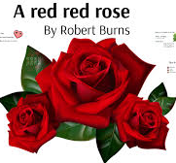
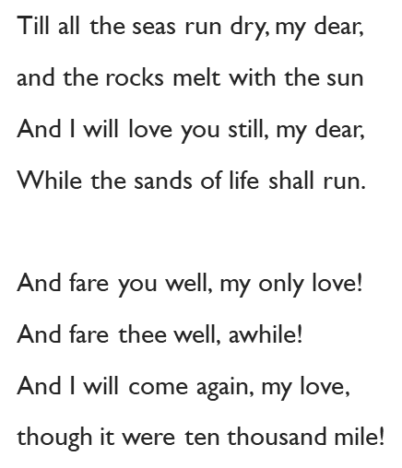
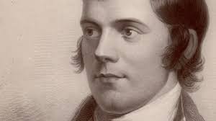
A Red, red rose
How do you understand this is a love poem?
1.Oh my Love is like a red, red rose, 3.
That’s newly sprung in June
Oh my Love is like the melody
That’s sweetly played in tune.
2.And you're so fair, my lovely lass, 4.
So deep in love am I,
And I will love you still, my dear,
Till all the seas run dry.

Slide 10
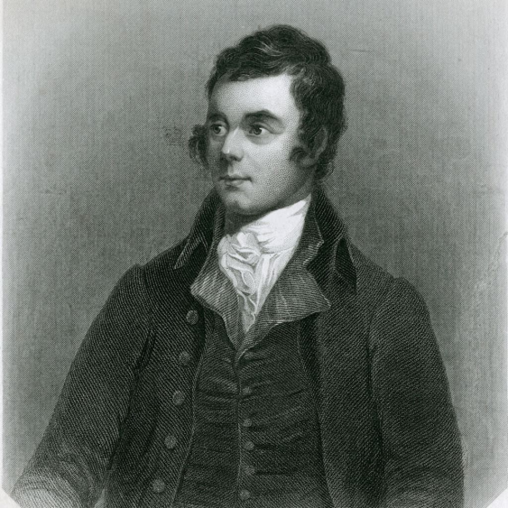
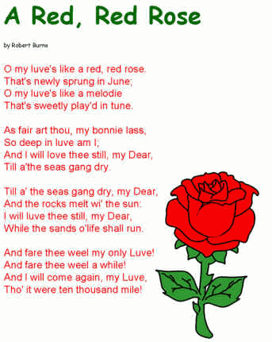
Other poems and videos
https://www.youtube.com/watch?v=qMxIBqpryG0 (The Story of Robert Burns)
https://www.youtube.com/watch?v=QK9WK0QhejA (My Love Is Like A Red Red Rose)
https://www.youtube.com/watch?v=5MV9H8VLI14&ab_channel=DMendoza
(Auld Lang Syne)

