Slide 1
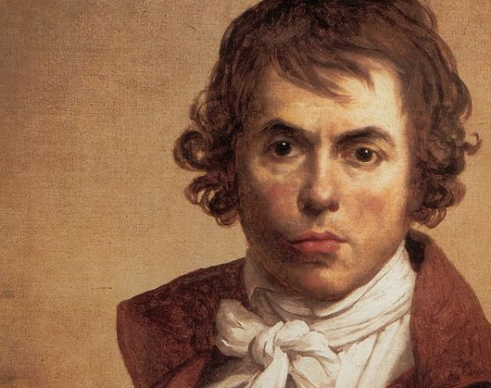
Jacques Louis David
By Joseph Galanakis
This Photo by Unknown author is licensed under CC BY-SA-NC.

Slide 2
So...
Jacques Louis David was a French painter that lived during the 18th – 19th century. You probably know already some of his paintings, but don`t remember his name. He mostly painted in the neoclassical style.
He was considered as the preeminent painter of his era. Throughout his life, he painted lots of historical events (that will be mentioned later), Greek gods and goddesses, Portraits etc...

Slide 3
To Summarize...
He was born in Paris (30th of August 1748) and lost his father at a young age. In school he wasn´t a good student, however, he was very passionate about drawing as he desired to be a painter. In class, he was always hiding behind the instructor's chair, drawing for the duration of the class.
Even though his family and relatives wanted him to become an architect, he managed to become what he hoped for. Then, in the 1780s, he began his journey as a painter. During those years he traveled to Italy, where he got inspired to paint Romans and other events around Rome.

Slide 4
A big proportion of his artwork was done in Italy. Later, Napoleon took control of France, a person who was admired and painted a lot by our artist. In the 29th of December 1825 he died after he got struck by a carriage. And then he went on to become one of the biggest names in all the history of art.
Some of his artworks include:

Slide 5
Napoleon crossing the Alps

Slide 6
National Convetion / Tennis Court Oath

Slide 7
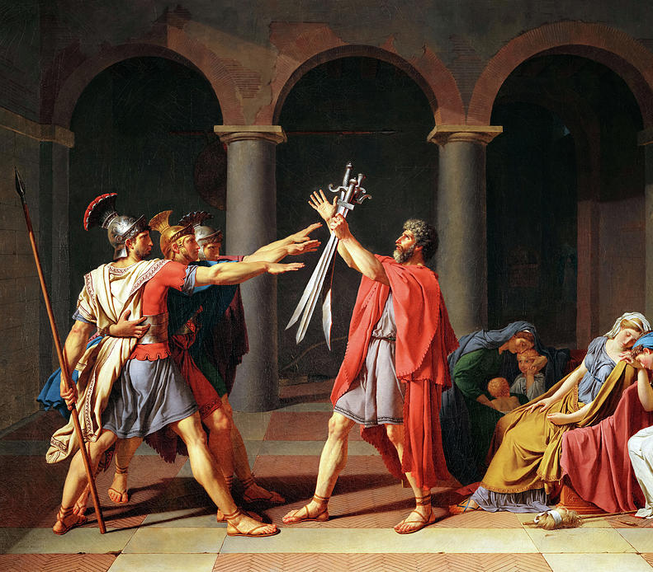
The Oath of Horatii

Slide 8
His Legacy
Jacques-Louis David was, in his time, regarded as the leading painter in France, and arguably all of Western Europe. He was more than just a painter, he was also a teacher. His pupils were inspired and well taught, because of that, they even managed to get a reputation of their own.
Following WW2 he was regarded as a symbol of French national pride and identity, as well as a vital force in the development of European and French art in the modern era. His legacy remains remarkable to this day and continues to inspire, from thousands to millions all over the world.

