Slide 1
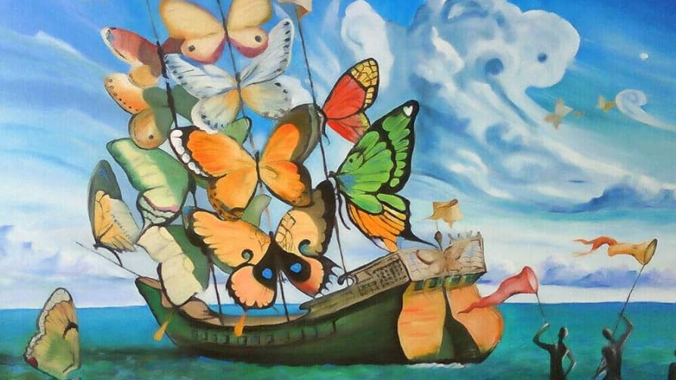
Salvador Dalí
By Maria Almetidou

Slide 2
Biography (1)
His full name is Salvador Domingo Felipe Jacinto Dalí i Domènech
Born in Figueres, Catalonia, Spain on 11 May 1904, died there on 23 January 1989
Studied arts in Madrid
Known for his surrealistic style, technical skills and bizarre images in his paintings

Slide 3
Biography (2)
Got closer to surrealism in the late 20s & joined a surrealist group in 1929
Lived in France during the Spanish civil war
Moved to the US in 1940
Returned to Spain 8 years later, when he announced his return to the Catholic faith

Slide 4
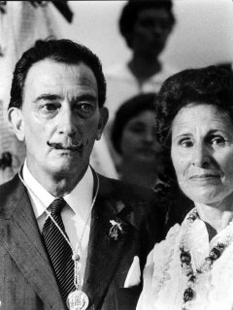
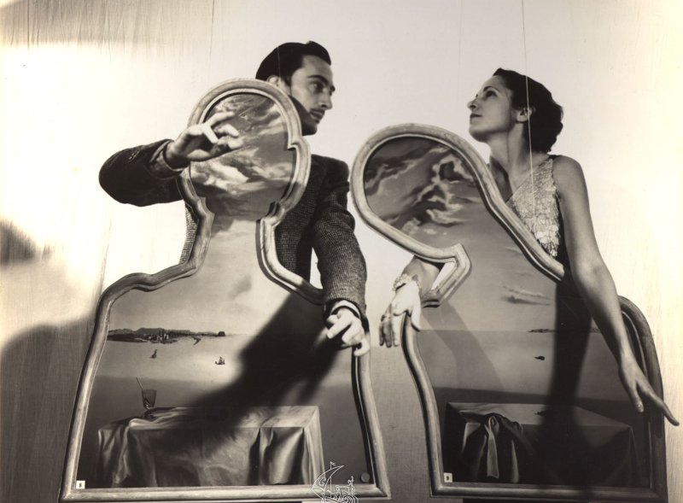
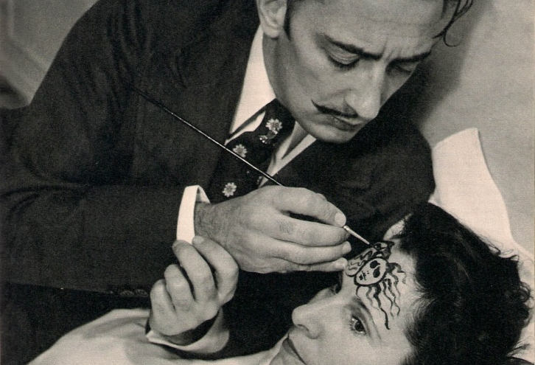
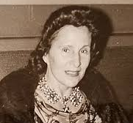
Marriage
Salvador Dali got married in 1958
His wife’s real name was Elena Ivanova Diakonova, known as Gala Dalí.
Gala was born in Russia
She was known as a mysterious & highly intuitive woman who could easily recognize an artistic and creative genius

Slide 5
Dalí’s arts
He worked with a variety of arts, some of which are:
Painting
Graphic arts
Film
Sculpture
Design
Photography
Poetry
Fiction
Autobiography etc

Slide 6
Dalí’s work themes and inspirations
Salvador was inspired by the landscapes of his life in Catalonia
He was also inspired by his wife, family members and friends.
His work themes included:
Dream images
The subconscious
Sexuality
Religion
Science and its Evolution
Relationships etc

Slide 7
Dalí’s most famous artwork
His most known artwork is called “The Persistence of Memory”, also known as the “melting clocks”
This painting depicts images more likely to be found in dreams rather than waking consciousness
It can be understood in several ways, as it hides many messages

Slide 8
Dalí’s symbols
Dalí often used food and animals to symbolize certain things.
He also used science to express the surrealistic point of view
In “the Persistence of Memory” he used ants as a symbol of decay and corruption
He also used Einstein’s theory of the relativity of time and space, by creating the “melting clocks”

Slide 9
Dalí’s recreation
“The disintegration of the persistence of memory” is a recreation of the original painting
Dalí covered the original landscape with water and transformed the ground to brick-like shapes, floating next to each other

Slide 10
Dalí’s museums
Two major museums are devoted to his work
The Dalí Theatre-Museum in Figueres, Spain
The Salvador Dalí Museum in St.Petersburg, Florida

Slide 11
Dalí’s Quote
“A true painter is one who can paint extraordinary scenes in the middle of an empty desert. A true painter is one who can patiently paint a pear in the midst of the tumults of history”
Sources: Wikipedia, Salvador-Dali.org

